Slide 1





Chinook Music Store
Presented By:
Baibhav Kumar

Slide 2
Agenda
Introduction
Problem Statement
Data Description
Key Metrics and Visualization
Conclusion

Slide 3
Introduction
1. The Chinook Music Store is a sample database that represents a digital media store, similar to iTunes.
2. It contains information about artists, albums, media tracks, customers, invoices, and employees.
3. The Chinook database provides a practical environment to learn data querying, reporting, and business insights generation in a real-world retail context.

Slide 4
🎵Problem Statement
The Chinook Music Store, a digital music retailer, maintains extensive data on customers, invoices, artists, albums, and employee interactions. However, the store lacks a comprehensive understanding of its sales performance, customer behavior, and genre preferences across different countries and markets.
Currently, decision-making is largely intuitive rather than data-driven, making it difficult to:
Identify the most profitable genres, artists, and albums.
Understand regional sales trends and customer purchasing habits.
Evaluate employee performance (sales representatives) across territories.
Develop effective marketing and promotion strategies for new record labels.
This project aims to transform Chinook’s raw data into actionable insights by performing data analysis and visualization on key business dimensions such as sales, customers, and genres. The goal is to help stakeholders make evidence-based decisions to improve revenue, enhance customer engagement, and optimize marketing efforts.

Slide 5
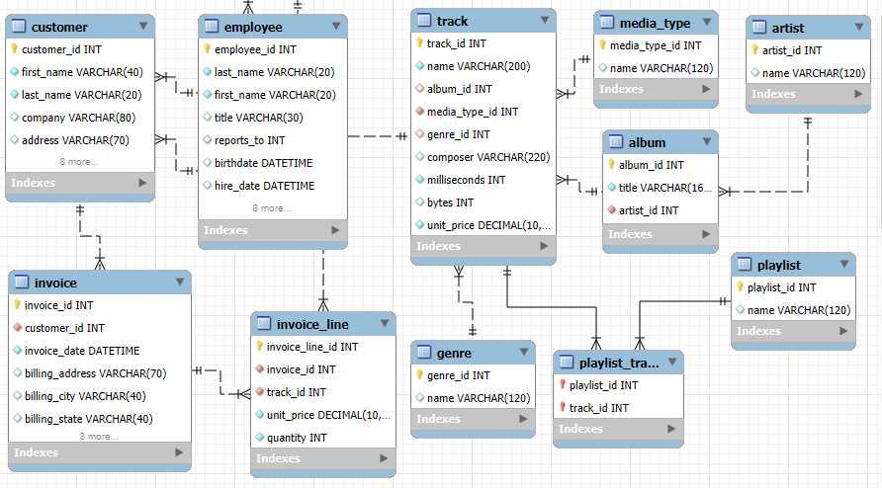
Database Schema

Slide 6
Data Description
customer:
customer_id: Unique identifier assigned to each customer.
first_name: The given name or first name of a customer.
last_name: The surname or family name of a customer.
company: The name of the company associated with a customer.
address: The street address of a customer's location.
city: The city where a customer is located.
state: The state or province where a customer is located.
country: The country where a customer is located.
postal_code: The postal or zip code of a customer's address.
phone: The phone number of a customer.
fax: The fax number associated with a customer.
email: The email address of a customer.
support_rep_id: The employee ID of the support representative assigned to a customer.

Slide 7
invoice:
invoice_id: Unique identifier assigned to each invoice.
customer_id: The customer ID associated with the invoice.
invoice_date: The date when the invoice was generated or issued.
billing_address: The street address used for billing purposes.
billing_city: The city used for billing purposes.
billing_state: The state or province used for billing purposes.
billing_country: The country used for billing purposes.
billing_postal_code: The postal or zip code used for billing purposes.
total: The total amount due on the invoice.
invoice_line:
invoice_line_id: Unique identifier assigned to each line item on an invoice.
invoice_id: The invoice ID to which the line item belongs.
track_id: The ID of the track or product included in the line item.
unit_price: The price per unit for the line item.
quantity: The quantity of units for the line item.
track:
track_id: Unique identifier assigned to each track or song.
name: The title or name of the track.
album_id: The ID of the album to which the track belongs.
media_type_id: The ID of the media type associated with the track.
genre_id: The ID of the genre associated with the track.
composer: The name of the composer or artist who composed the track.
milliseconds: The duration of the track in milliseconds.
bytes: The file size of the track in bytes.
unit_price: The price per unit for the track.
playlist:
playlist_id: Unique identifier assigned to each playlist.
name: The name or title of the playlist.
playlist_track:
playlist_id: The ID of the playlist to which the track belongs.
track_id: The ID of the track included in the playlist.

Slide 8
Employee:
• employee_id : It shows unique id of customer.
• Last_name : it shows the last name of the employee.
• first_name: it shows the first name of the employee.
• title: The title or name of the album.
• reports_to: It shows the which person you have to report.
• hire_date: which date the employee hired in the company.
• birth_date: it shows employee birth_date.
•address: employees where they leave.
• city: which city employee stay or leave.
• state: from which state employees are.
• postal_code: it shows employees near by postal_code.
• fax: it shows employee fax number or id.
• email: email of the employees.
• phone: employees phone number.
album:
album_id: Unique identifier assigned to each album.
title: The title or name of the album.
artist_id: The ID of the artist associated with the album.
artist:
artist_id: Unique identifier assigned to each artist.
name: The name of the artist.
media_type:
media_type_id: Unique identifier assigned to each media type.
name: The name or description of the media type (e.g., MPEG audio file, AAC audio file).
genre:
genre_id: Unique identifier assigned to each genre.
name: The name or description of the genre (e.g., rock, pop, classical).

Slide 9
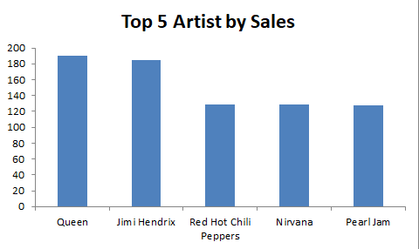
Key Metrics and
Visualization
This chart shows the top 5 Artist by total revenue and total no of tracks sold.
Queen’s dominance in both revenue and volume suggests high cross-demographic appeal and strong catalog monetization—ideal for premium bundling or exclusive releases.
The lower sales figures for Nirvana and Pearl Jam may indicate underutilized catalog potential, presenting an opportunity for targeted campaigns or curated playlists to boost engagement.

Slide 10
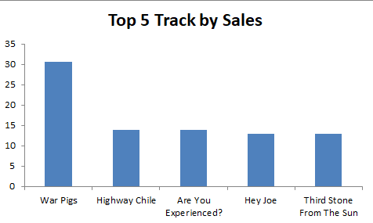
Top 5 Track by Sales
"War Pigs" dominates sales ,providing major audience appeal. Multiple Hendrix tracks show strong fan engagement – ideal for themed promotions. ”Put The Finger on you” holds niche potential for targeted marketing.

Slide 11
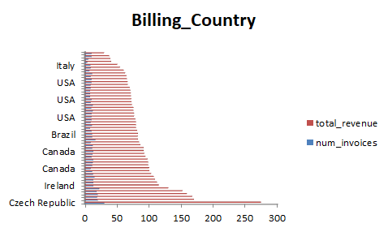
Billing Country by Total Revenue and No. of Invoices
The Czech Republic leads in both revenue and invoice volume, indicating a highly engaged and profitable customer base.
Italy shows the lowest revenue and invoice volume among the listed countries, suggesting limited market penetration or low customer engagement—this highlights an opportunity for targeted growth initiatives or deeper market analysis. Italy has to focus on marketing skills to sells more track, genres .

Slide 12
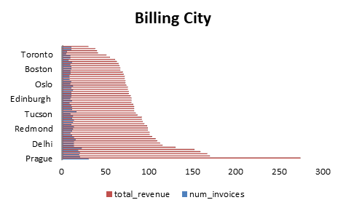
Billing City by Total Revenue and No. of Invoices
Prague emerges as the top-performing city in both revenue and invoice volume, signaling a strong and active customer base—ideal for deepening engagement through loyalty programs or exclusive releases.
The disparity between revenue and invoice count across cities (e.g., high revenue with fewer invoices) points to varying average order values—this insight can guide pricing strategies and customer segmentation.

Slide 13
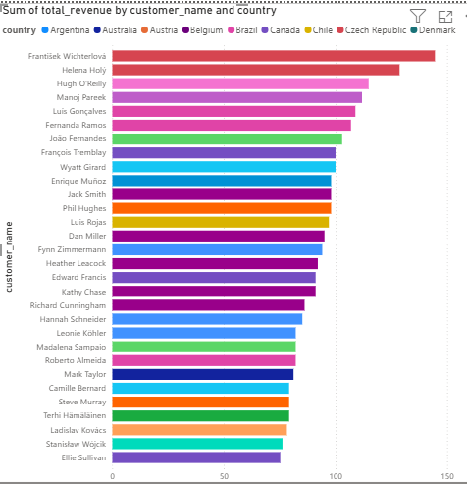
Top Revenue-Generating Customers Across Global Markets
František Wichterlová (Czech Republic) leads all customers in total revenue, making Czech Republic a standout market for premium engagement and retention strategies.
Color-coded country segmentation reveals regional revenue clusters, enabling quick identification of high-performing markets and guiding resource allocation for customer success initiatives.

Slide 14
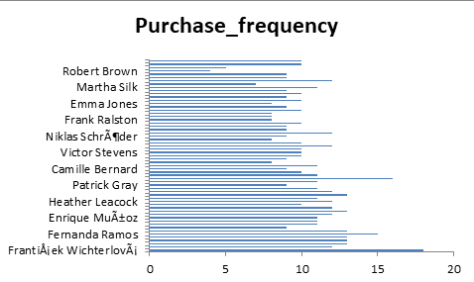
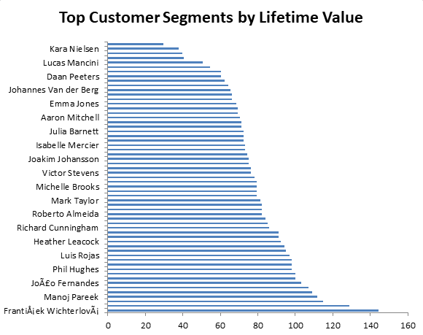
High-Value Customer Profiles: Purchase Behavior & Lifetime Value
František Wichterlová stands out with the highest lifetime value, driven by frequent purchases—an ideal candidate for loyalty rewards or exclusive offers.
Helena Holý has the highest average order value, suggesting premium product affinity and potential for upselling or bundled promotions.
Consistent performers like Hugh O'Reilly, Manoj Pareek, and Luís Gonçalves show balanced frequency and spending, indicating strong engagement and retention potential across diverse regions.

Slide 15
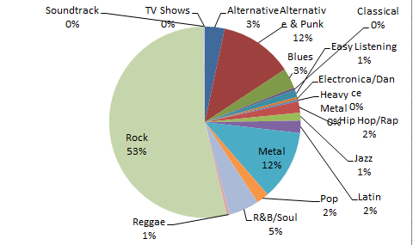
Genre-Wise Sales Contribution
Rock dominates the market — accounting for over 50% of total sales.
Alternative & Punk (12%) and Metal (12%) follow, showing strong niche fan bases.
R&B/Soul and Blues make up moderate shares, indicating cross-genre popularity.
Genres like Pop, Jazz, and Latin contribute smaller portions — possible opportunity areas for marketing expansion.

Slide 16
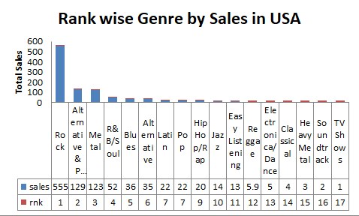
Genre Sales Ranking in the USA
Rock leads by a wide margin, accounting for over half of total sales—making it the clear priority for promotional campaigns, catalog expansion, and artist partnerships.
Alternative & Punk and Metal rank 2nd and 3rd, showing strong niche appeal and fan loyalty—ideal for targeted merchandising and bundled releases.
Genres like R&B/Soul, Blues, and Latin show moderate traction, suggesting potential for growth through curated playlists, cross-genre collaborations, and regional targeting.

Slide 17
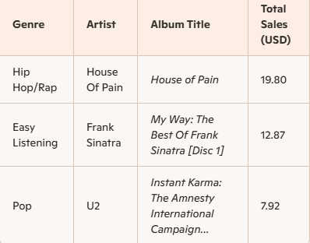
Strategic Promotion of Underperforming Genres in the U.S.A Market
Genre Growth
Hip Hop/ Rap, Easy listening ,Pop offer high-growth potential with focused marketing.
Artist Leverage
Use legacy artists like Frank Sinatra and U2 for nostalgic, cross-generational appeal.
Market Tactics
Apply geo-targeted ads, playlists, and bundles to increase reach in underperforming regions.

Slide 18
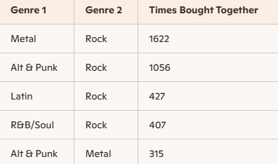
Product Affinity Analysis on Genres
Metal & Rock (1622 purchases together)
Alternative & Punk & Rock (1056 purchases together)
These combinations suggest natural listening overlaps and fanbase synergy.
Leverage genre pairings to power personalized recommendations.
Promote albums from paired genres together in email campaigns, app suggestions, and store displays.

Slide 19
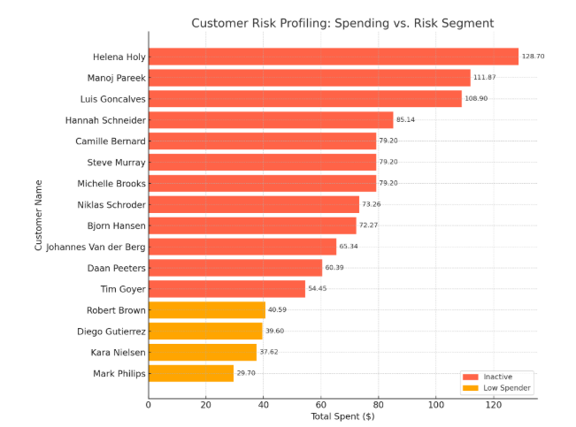
Behavior-Based Risk Segmentation for Churn Prevention
Majority of customers are inactive
Over 90% of the profiled customers show no recent purchases, indicating high churn risk.
Low spenders signal weak engagement
Customers spending under $50 are less likely to convert long-term—ideal for reactivation campaigns.
Recency-based prioritization enables smart targeting
Sorting by last purchase date helps focus retention efforts on those most likely to churn soon.

Slide 20
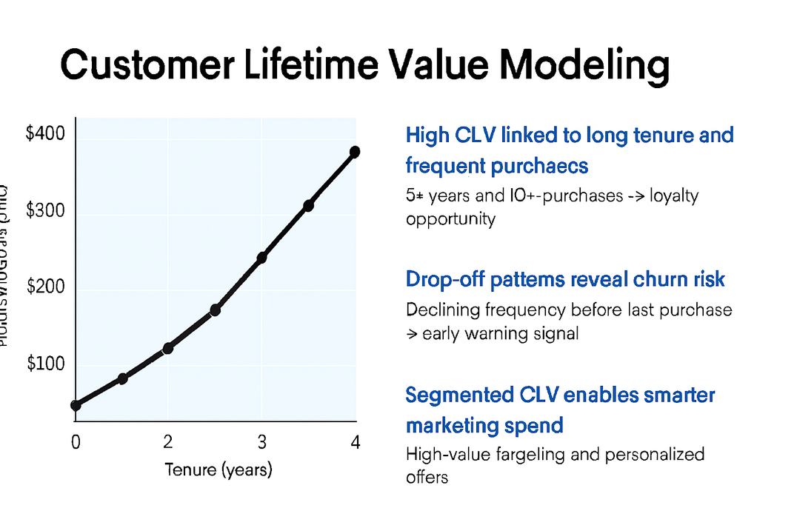
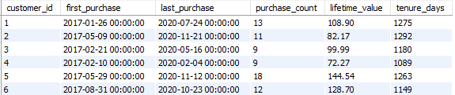
Customer Lifetime Value
Customers with 3+ years and 10+ purchases consistently show higher lifetime value—ideal for loyalty programs and premium targeting.
Declining frequency before last purchase is a common pattern among churned customers—use this as an early warning for retention.
Predicting CLV helps prioritize high-value customers and personalize offers for low-engagement segments—maximizing ROI.
this is sample data ------>

Slide 21

Conclusion
This analysis ensured clean, reliable data and revealed key insights: Rock and Metal dominate sales, loyal customers drive high value, and top regions like the USA and Europe lead revenue. Cross-genre affinities and customer segmentation enable targeted marketing, retention, and bundling strategies. Predictive CLV and scalable Sql workflows support ongoing, data-driven deision-making.

Slide 22

Thank You
The Chinook Music Store Project has been a journey through the rhythm of data — exploring sales hits, customer favorites, and the patterns that make the business sing.

